Slide 1
HOW TO PUBLISH storytelling research AND NOT HAVE WRITER’S BLOCK?
Slides & books to download at http://davidboje.com/Strathclyde/
TIME: 4PM to 5PM
I ‘HOW TO PUBLISH’ events give everyone writer’s block
II What Gives us Writer’s Block?
III. What to do about Writer’s Block?
III How to help others overcome writer’s block?
IV. Interactive event to develop your kind of living story, narrative, or antenarrative approach to writing?
David M. Boje

Slide 2
The Essence of Scholarly Impact | BizEd Magazine bized.aacsb.edu
WHAT IS THE MEANING of scholarly impact? How can researchers know when they’ve achieved it, and how can their schools best reward it? These nuanced questions are the subject of a project from the Academy of Management (AOM)
Top 5 indications include publication in top-tier journals, citations by other researchers, use as the basis of a scholarly book, ability to attract competitive grants, and publication in practitioner-focused outlets.
BUT majority of respondents find that journal lists, journal rankings, & impact factors “definitely” or “probably” do not reflect journal quality or scholarly impact, BUT measures are still used widely by academic institutions to evaluate faculty contributions. TIME FOR A CHANGE

Slide 3
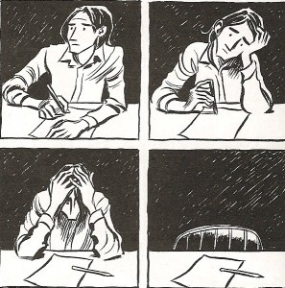
Writer’s Block
Most editor’s ‘HOW TO PUBLISH’ events give everyone writer’s block
The editor gets in-your-head and blocks everything creative

Slide 4
DON’T GO TO EDITOR’S WORKSHOPS
They infect you with writer’s block
The editor gets in your head

Slide 5
AACSB Gives me Writer’s Block
Asking Business Schools to develop metrics of research impact
Its an example of Numeric-Multiplicity
And it gives people writer’s block

Slide 6
Citation Analysis – gives me writer’s block
Total Cites
Total Cites (without self cites)
H-Index
Max Cites
Blockbusters (>100 cites)

Slide 7
Your RANKING in your DISCIPLINE as of Jan 17 2018
Citation Impact for 3 Narrative Scholars
Barbara Czarniawska cited by 24,884
David Boje cited by 14,253
Yiannis Gabriel cited by 10,879

Slide 8
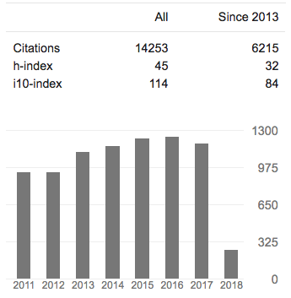
University wants Impact Factors, and it gives me writer’s block to focus on SHORT TERM H-Index & i10-Index
h-index, author-level metric, measures both productivity & citation impact of publications of scientist or scholar. Index based on scientist's most cited papers & the number of citations that they have received in other publications
i10 index refers to the number of paper with 10 or more citations

Slide 9
You are your Citation Impact on Jan 17 2018 – give me writers block
Boje, D. M. (2001). Narrative methods for organizational & communication research. Sage. Cited by 2191
Boje, D. M. (1991). The storytelling organization: A study of story performance in an office-supply firm. Administrative science quarterly, 106-126. Cited by 2050
Boje, D. M. (1995). Stories of the storytelling organization: A postmodern analysis of Disney as “Tamara-Land”. Academy of Management journal, 38(4), 997-1035. Cited by 1513

Slide 10
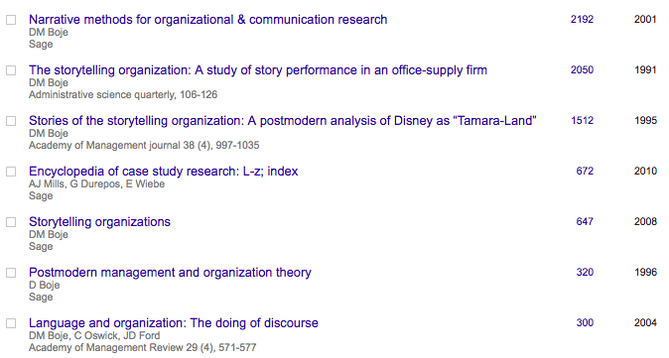
You are your Numeric? – give me writers block

Slide 11
QUALITIATIVE IMPACTS of your Research on PRACTICE
Please provide examples/details of changes in business performance/practices arising from your research
I did a sting on smoke shops selling SPICE, fake weed, to get City Council to change the law
I worked with homeless veterans to introduce a drug policity, to stop the sale at the point of sale, the Smoke Shop selling SPICE, K-2, Bath Salts laced with who knows what designer chemicals.

Slide 12
IMPACTS of your Research on SOCIETY
Please provide examples/details of the influence of your research on local/regional communities and/or the wider society.
Jeanne Flora, David Boje, Grace Ann Rosile, Kenneth Hacker. (2016). Journal of Veterans Studies. Vol 1, No 1 http://veteransstudies.org/journal/index.php?journal=jvs&page=issue&op=view&path%5B%5D=1
Boje, D. M.; Hillon, Yue. 2017. "The Dialectical Development of “Storytelling” Learning Organizations: A Case Study of a Public Research University” its death spiral: can we reverse it?

Slide 13
1. Give yourself permission to write first, edit later 2. Have place & time to write each day 3. Write FAST as much as you can in 5 minutes 4. Turn idea into a living story
What to do about Writer’s Block
Our need to be perfect blocks our CREATIVE STORY-FLOW

Slide 14
How to overcome writer’s block?
I need a spacetimemattering of CREATING
Find a place to meditate and write EVERYDAY (or find change of scenery)
Write about what comes to mind
Have your special time to meditate and then write in the middle – jump to the middle and the beginning will come
Mattering with Good tools
Get in touch with your muse
Note-booking before computer-writing

Slide 15
How I help others overcome it?
I write a starting sentence, get up and
Ask them to write the next sentence
Then I write another sentence, and REPEAT
Within 5 minutes they are off writing many sentences

Slide 16
Advice
Don’t let the university & academy Outcomes Asessment define your path
Write for the Long-term
Do something that Matters to You
Make a difference in the World with your writing
Always have a Plan B when you submit to Top Tier
Work on the Writers Block that Rejection Brings
Take Time to Celebrate each Small Win

Slide 17
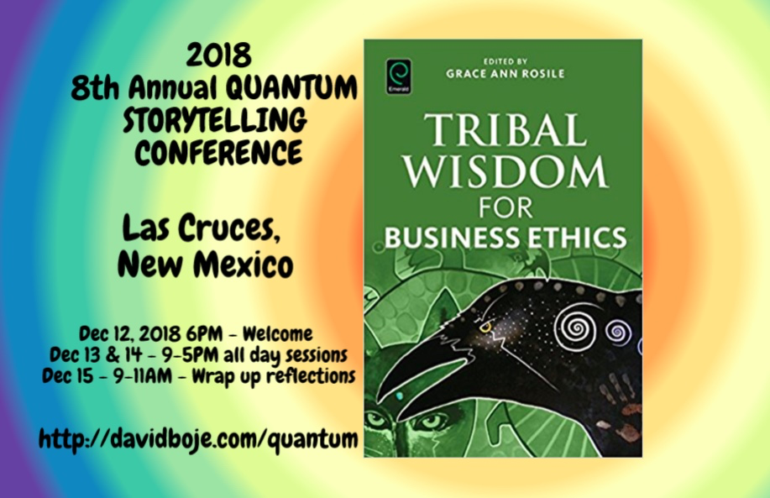
Q & A
Slides & books to download at http://davidboje.com/Strathclyde/

